Slide 1


AI-Driven Predictive Maintenance System for Rotating Machinery using Multisensory Data
Branch: B.Tech Artificial Intelligence and Data Science
Academic Year: 2025 – 2026
Guide:
Ms.S.Anitha
Assistant Professor of AI&DS
Team Members:
Bal Abisheak C (952022243010)
Francies T (952022243016)
Vinay Prasath R (952022243049)

Slide 2
OBJECTIVES
To design and implement a real-time multisensory monitoring system that continuously collects vibration, temperature, electrical, and acoustic data from rotating machinery.
To develop an AI-based fault detection model capable of identifying abnormal operating conditions and predicting potential mechanical and electrical failures.
To analyze machine health trends and estimate remaining useful life (RUL) using machine learning techniques for accurate maintenance planning.
To minimize unplanned downtime and optimize maintenance strategies by enabling condition-based, data-driven decision making in industrial environments.

Slide 3
ABTRACT
Industrial rotating machines such as motors, pumps, and compressors are critical to manufacturing and production systems, but unexpected failures can cause serious downtime, financial loss, and safety risks. Traditional maintenance methods like reactive or scheduled maintenance are not efficient enough to prevent sudden breakdowns. To overcome this problem, this project proposes an AI-Driven Predictive Maintenance System for Rotating Machinery using Multisensory Data.
In this project, multiple sensors including accelerometer (vibration), current sensor, voltage sensor, sound sensor, and temperature sensor are used to continuously monitor machine health in real time. The collected data is processed using machine learning algorithms to detect abnormal patterns and predict possible faults before failure occurs. The system provides early warning alerts and maintenance predictions, helping industries reduce downtime, improve efficiency, and extend machine life.

Slide 4
SYSTEM REQUIREMENTS
HARDWARE REQUIREMENTS
Arduino (Microcontroller) Acts as the main controller to collect data from all sensors and manage system operations.
MPU6050 (Accelerometer Sensor) Used to measure vibration and motion of rotating machinery to detect imbalance or abnormal movement.
LM35 (Temperature Sensor) Used to monitor machine temperature and detect overheating conditions.
Current Sensor ( ACS712) Used to measure the current consumption of the motor. Helps detect overload and abnormal power usage.
Voltage Sensor Module Used to monitor the supply voltage of the machine and identify voltage fluctuations or electrical faults.
ESP8266 (Wi-Fi Module) Used to transmit sensor data wirelessly to the PC or cloud for AI-based analysis.
Power Supply (5V DC) Provides regulated power to Arduino and all connected module

Slide 5
SOFTWARE REQUIREMENTS
Python – Used to analyze sensor data and perform machine learning prediction.
Arduino IDE – Used to program the microcontroller and read data from sensors.
Scikit-Learn / TensorFlow – Used to create the machine learning model that predicts machine faults.
NumPy and Pandas – Used to process and organize the sensor data.
Matplotlib – Used to display graphs of vibration, temperature, and other sensor data.
Windows / Linux – Operating system used to run the software.z

Slide 6
EXISTING SYSTEM
Multi-Component Fault Prognostic Framework The existing system proposes a prognostic framework designed to analyze rotating machinery under multi-component fault conditions. It focuses on modeling complex fault interactions between different machine components to improve failure prediction accuracy.
Data-Driven Fault Modeling Approach The system primarily relies on historical operational data and condition monitoring signals to develop predictive models. Machine learning techniques are applied to detect degradation patterns and estimate the progression of faults over time.
Component-Level Health Assessment The framework evaluates the health condition of individual components within rotating machinery, enabling fault diagnosis and prediction at a more granular level rather than treating the machine as a single unit.
Limited Real-Time Multisensory Integration Although the system provides advanced prognostic capabilities, it mainly emphasizes fault modeling and prediction algorithms, with limited focus on real-time multisensory data fusion and edge-level implementation for practical industrial deployment.

Slide 7
DISADVANTAGES OF EXISTING SYSTEM
High Computational Complexity The prognostic framework involves advanced fault modeling and data processing techniques, which may require high computational resources and powerful hardware, limiting real-time industrial implementation.
Dependence on Large Historical Datasets The system heavily relies on extensive historical fault data for accurate prediction. In practical industrial environments, obtaining labeled multi-component fault datasets can be difficult and time-consuming.
Limited Real-Time Edge Deployment The framework focuses mainly on analytical modeling and simulation-based validation, with limited emphasis on real-time edge-based deployment for on-site monitoring and instant alert generation.
Complex Fault Interaction Modeling Modeling multiple interacting component faults increases system complexity, which may reduce scalability and make practical maintenance decision-making more complicated for operators.

Slide 8
PROPOSED SYSTEM
AI-Driven Multisensory Monitoring Architecture We propose an intelligent predictive maintenance system that integrates multiple sensors such as accelerometer (vibration), current sensor, voltage sensor, sound sensor, and temperature sensor to continuously monitor rotating machinery in real time.
Real-Time Data Acquisition and Fusion Unlike traditional single-parameter monitoring systems, our proposed system performs multisensory data fusion to improve fault detection accuracy. Combining mechanical, electrical, and thermal parameters provides a more comprehensive understanding of machine health.
Machine Learning-Based Fault Prediction Model We propose implementing machine learning algorithms to analyze sensor data, detect anomalies, classify fault types, and estimate the Remaining Useful Life (RUL) of components. This enables early warning alerts before critical failure occurs.
Low-Cost, Scalable, and Industry-Ready Solution The proposed system is designed to be modular, scalable, and suitable for real-time industrial deployment. It reduces computational complexity while providing actionable maintenance insights, helping industries minimize downtime and maintenance costs.

Slide 9
ADVANTAGES OF PROPOSED SYSTEM
1. Improved Fault Detection Accuracy
Multisensory data fusion (vibration, temperature, current, sound, voltage)
Provides comprehensive machine health analysis
2. Early Fault Prediction
Machine Learning enables:
Anomaly detection
Fault classification
Remaining Useful Life (RUL) estimation
3. Real-Time Monitoring & Decision Making
Continuous data acquisition
Instant alerts for abnormal conditions
4. Reduced Downtime & Maintenance Cost
Predicts failures before occurrence
Enables proactive maintenance planning
5. Edge + IoT Integration
Faster processing with low latency
Reduced dependency on cloud systems
6. Scalable and Modular Design
Easy to expand with additional sensors
Suitable for large industrial environments
7. Low-Cost Implementation
Uses affordable hardware (Arduino, sensors)
Industry-friendly and cost-effective solution
8. High Reliability & Efficiency
Combines multiple parameters → better accuracy
Improves overall equipment performance

Slide 10
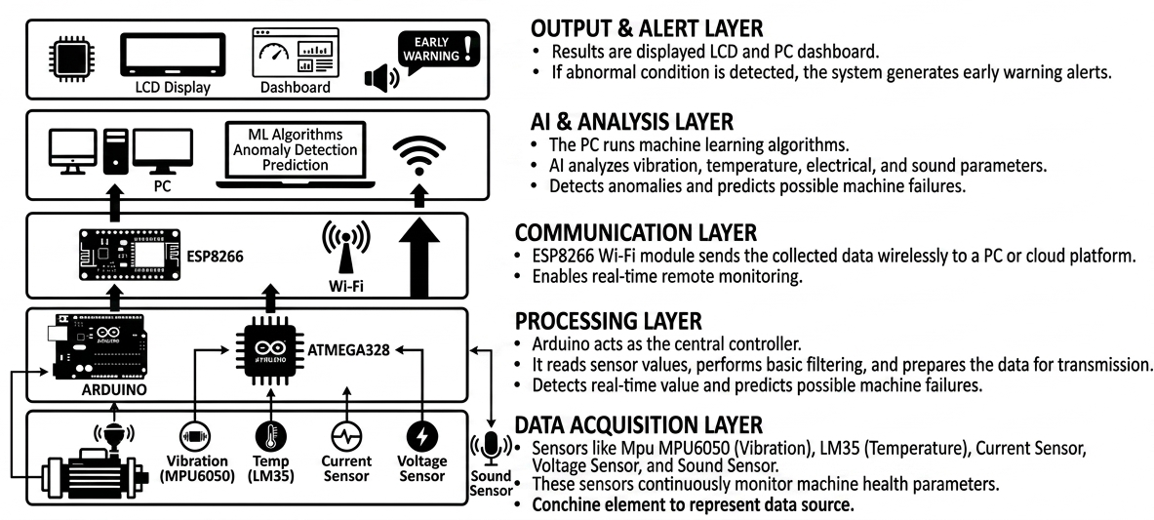
ARCHITECTURE DIAGRAM

Slide 11
BLOCK DIAGRAM
POWER SUPPLY FOR ALL UNITS
MICROCONTROLLER
IOT-ESP8266
ACCELEROMETER SENSOR
CURRENT SENSOR
USB TO UART
SOUND SENSOR
PC(AI)
TEMPERATURE SENSOR
VOLTAGE SENSOR
LCD DISPLAY

Slide 12
ALGORITHM
Core Algorithm: Rule-Based Fault Detection :
The central algorithm evaluates real-time data from various sensors against pre-configured thresholds.
Decision Logic: It uses a priority-ordered sequence of "if-else if" conditional statements to classify the machine's state into one of several categories: Normal operation (OK) or one of five fault classes (TILT, HOT, NOISE, OVERLOAD, or VOLT ERR)
Edge Processing: This logic runs locally on the Arduino, allowing for immediate alerting even without an active internet connection.
2. Signal Processing and Scaling
Before fault detection, the system applies specific calculations to raw sensor data:
Scaling & Calibration: Raw ADC values are converted into physical units (e.g., Celsius for temperature, Amperes for current, and 'g' for acceleration).
Euclidean Norm: For vibration monitoring, the total acceleration magnitude is computed as the Euclidean norm of the X, Y, and Z axes from the MPU6050 sensor.
Tilt Calculation: The atan2() function is applied to accelerometer components to derive the tilt angle

Slide 13
Decision Tree Classifier :
The system integrates a Decision Tree Classifier via the Scikit-Learn library in the Python backend. This algorithm serves as the primary intelligence for high-level classification:
Model Training: The algorithm is trained on a dataset (Machine.csv) containing historical sensor readings (Tilt, Temperature, Sound, Current, and Voltage) and their corresponding labels.
Binary Classification: During real-time operation, the Decision Tree processes the incoming data stream to classify the machine state as either 0 (Normal) or 1 (Abnormal).
Automated Response: When the classifier detects an abnormal state, it triggers a "1" signal back to the hardware and initiates an automated email alert system using the smtplib library.

Slide 14
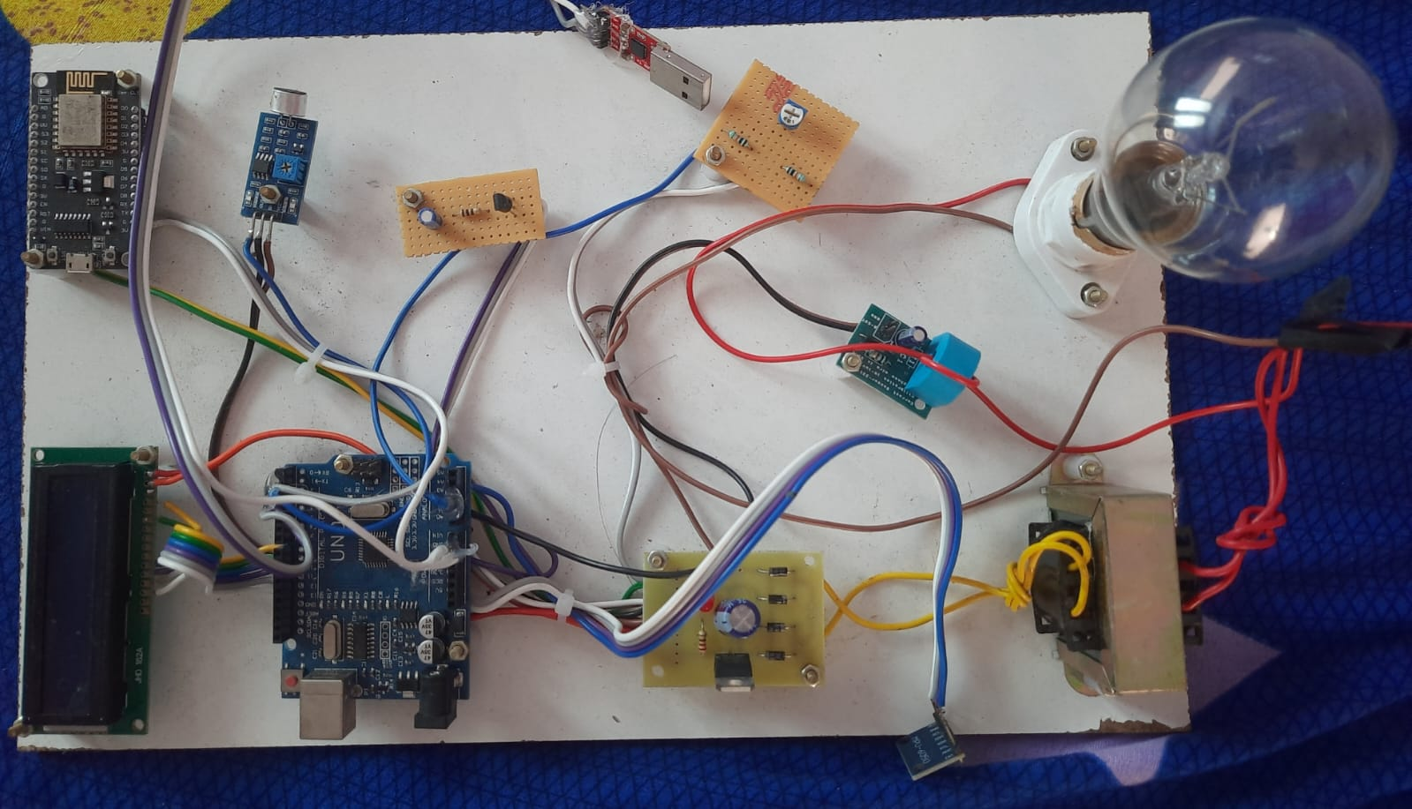
MODULE

Slide 15
MODULE DESCRIPTION
ARDUINO UNO :
The arduino uno is an open source board, also referred to as a microcontroller board.
Arduino UNO R3 uses ATmega328P microcontroller as the main control and processing unit of the board. The Atmega328P has 32kB In-System Programmable Flash Memory, 1kB EEPROM, and 2kB internal SRAM.
The UNO board provides access to 14 Digital I/O pins (0-13 in above image).
Of these 14 digital I/O pins, 6 pins can be used as PWM pins(pins 3,5,6,9,10 and 11).
The PWM pins are indicated by ~ before the pin number on the Arduino UNO boards (E.g. ~3).
Digital pins 0 and 1 are the serial communication pins RX and TX respectively.
6 pins are available for use as Analog input pins (A0-A5).
The analog pins can be used as digital I/O pins as well if there is no analog input to be measured.
Its operating 7-20 volts of input voltage
A type-B USB cable is used to connect the Arduino board to the computer system. It contains everything needed to support the microcontroller; simply connect it to a computer with a USB cable or power it with a AC-to-DC adapter or battery to get started.
A battery (Fixed voltage, the voltage must be in the range of 7V to 12V). Battery terminals must be connected between VIN and GND pins on the board.

Slide 16
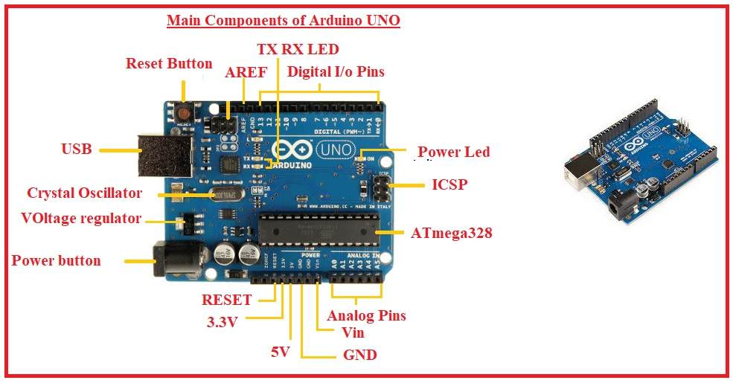
ARDUINO UNO :
In this project we are used ultrasonic sensor, servo motor and lcd for object detecting, those are connected in analog pins and digital pins. There are digital and analog pins for input/output. The board has 14 digital and 6 analog pins.
These the two sensors are connected in analog pins(A0,A1) and lcd is connected digital pins(4,5,6,7,8,9).
Collected data from the sensor to send the UART communication and used the RX,TX to transmit the value serial communication. Then the sensor values are displayed in the lcd.

Slide 17
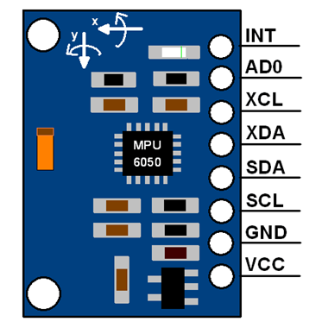
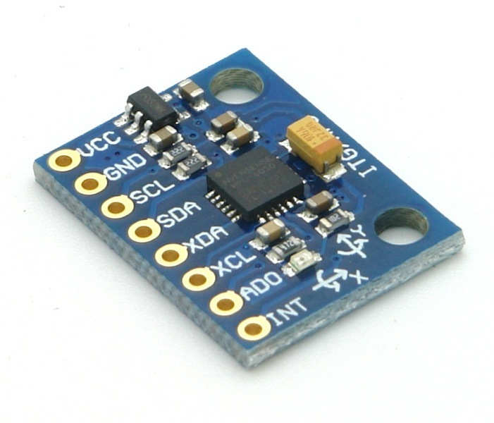
MPU6050-INTRODUCTION :
MPU6050 is a 6-axis Motion Tracking Device (3-axis Gyroscope + 3-axis Accelerometer)
Includes on-chip Temperature Sensor and Digital Motion Processor (DMP)
Communicates via I2C bus (up to 400kHz)
Supports Auxiliary I2C for additional sensors (e.g., Magnetometer → 9-axis fusion)
Applications: Motion detection, gesture recognition, fall detection, robotics, IoT health monitoring
Working Principle & Pinout :
Gyroscope (MEMS)
Detects rotational velocity (X, Y, Z axes) using Coriolis Effect
Range: ±250, ±500, ±1000, ±2000 dps
Accelerometer (MEMS)
Detects tilt/inclination & acceleration (X, Y, Z axes)
Range: ±2g, ±4g, ±8g, ±16g
DMP:
Fuses motion data → roll, pitch, yaw, orientation
Pinout:
VCC (3.3–5V), GND, SDA, SCL, INT, AD0 (I2C address select), XDA, XCL

Slide 18
IOT-ESP 8266 :
The ESP8266 NodeMCU micro-controller board is used as a central unit of this system.
The NodeMCU(ESP8266) is wifi enabled Microcontroller with an open-source platform.
Both hardware and software are framed in such a way that it is a very inexpensive Wi-Fi SoC (system on a chip) i.e. ESP8266.
It is designed from Espressif systems.
It is an excellent choice for IoT projects because of its low cost and easy interfacing with various parametric sensors and other devices.
It can be programmed in both LUA scripts and Arduino IDE software.
It can be easily communicated with the IoT platform based on the HTTP protocol.
Interfaced with cloud storage using API keys (Application Program Interface) therefore easily accessed by the user.
NodeMCU Dev Kit has Arduino like Analog (i.e. A0) and Digital (D0-D8) pins on its board.
It supports serial communication protocols i.e. UART, SPI, I2C, etc.
Using such serial protocols we can connect it with serial devices like I2C enabled LCD display, Magnetometer HMC5883, MPU-6050 Gyro meter + Accelerometer, RTC chips, GPS modules, touch screen displays, SD cards, etc.
Features
Microcontroller: Tensilica 32-bit RISC CPU Xtensa LX106
Operating Voltage: 3.3V
Input Voltage: 7-12V
Digital I/O Pins (DIO): 16
Analog Input Pins (ADC): 1
UARTs: 1
SPIs: 1
I2Cs: 1
Flash Memory: 4 MB
SRAM: 64 KB
Clock Speed: 80 MHz
USB-TTL based on CP2102 is included onboard, Enabling Plug n Play
PCB Antenna
Small Sized module to fit smartly inside your IoT projects

Slide 19
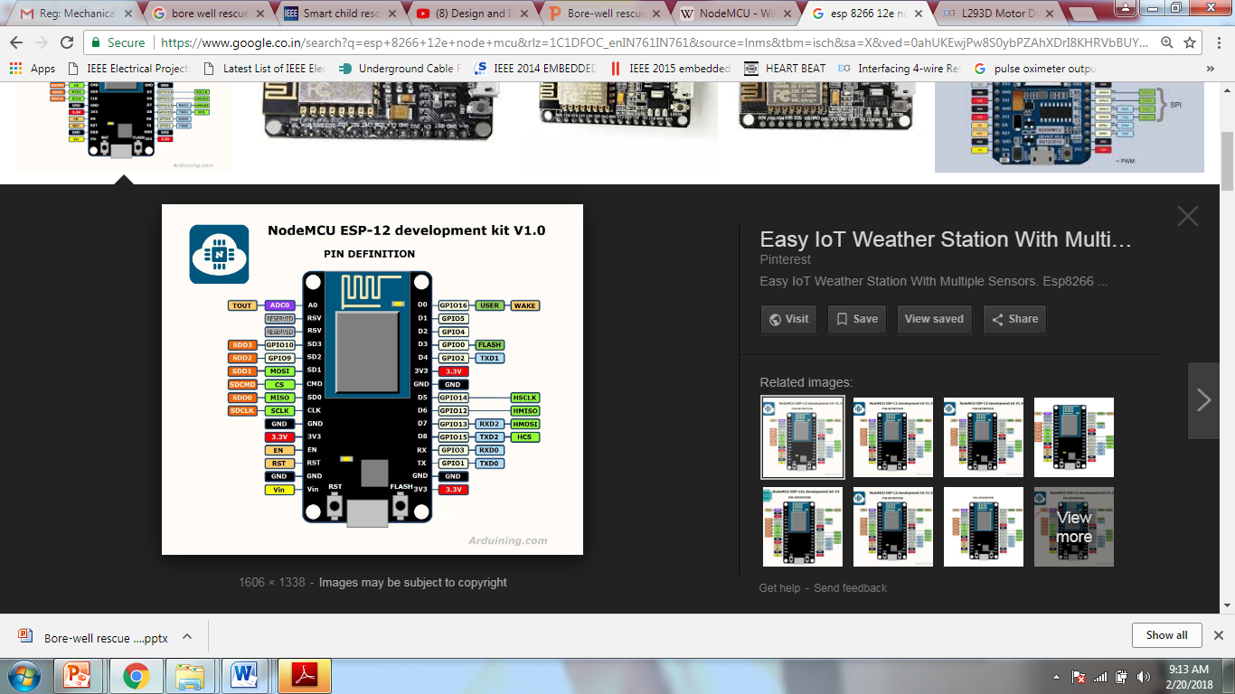
PIN CONFIGURATION IOT-ESP 8266 :
Pin Category | Name | Description
Power | Micro-USB, 3.3V, GND, Vin | Micro-USB: NodeMCU can be powered through the USB port 3.3V: Regulated 3.3V can be supplied to this pin to power the board GND: Ground pins Vin: External Power Supply
Control Pins | EN, RST | The pin and the button resets the microcontroller
Analog Pin | A0 | Used to measure analog voltage in the range of 0-3.3V
GPIO Pins | GPIO1 to GPIO16 | NodeMCU has 16 general purpose input-output pins on its board
SPI Pins | SD1, CMD, SD0, CLK | NodeMCU has four pins available for SPI communication.
UART Pins | TXD0, RXD0, TXD2, RXD2 | NodeMCU has two UART interfaces, UART0 (RXD0 & TXD0) and UART1 (RXD1 & TXD1). UART1 is used to upload the firmware/program.
I2C Pins |  | NodeMCU has I2C functionality support but due to the internal functionality of these pins, you have to find which pin is I2C.

Slide 20
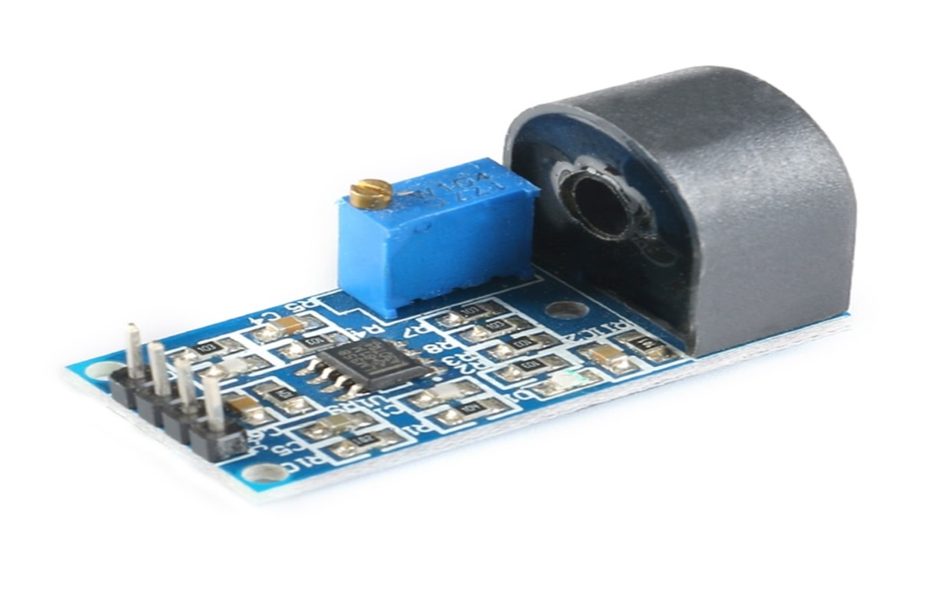
CURRENT TRANSFORMER(CT):
The C.T. is act as current sensor which place series with the load. Basic function of current transformer is to step down and calculate the current.
C.T load of 330 ῼ is connected on secondary winding of C.T.
A current transformer is a type of "instrument transformer" that is designed to provide a current in its secondary which is accurately proportional to the current flowing in its primary.
Then AC signal rectification done DC analog signal is transferred to the analog pin of Arduino Board Platforms analog pin(A0).
Then the Gas sensor value is displayed in the LCD and also updated in the IOT Cayenne app.

Slide 21
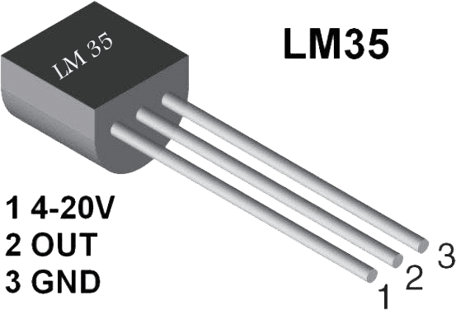
TEMPERATURE SENSOR :
A temperature sensor is an electronic device that measures the temperature of its environment and converts the input data into electronic data to record, monitor, or signal temperature changes.
LM35 is a temperature measuring device having an analog output voltage proportional to the temperature.
It provides output voltage in Centigrade (Celsius). It does not require any external calibration circuitry.
The sensitivity of LM35 is 10 mV/degree Celsius. As temperature increases, output voltage also increases.
It is a 3-terminal sensor used to measure surrounding temperature ranging from -55 °C to 150 °C.
LM35 gives temperature output which is more precise than thermistor output.
The temperature sensor operating voltage is 5V.
Temperature sensors are also used in the field; for example, thermometers play a vital role in geotechnical monitoring and renewable energy.
The output voltage is proportional to Celsius temperature scale and changes by 10mV per °C.
It has has Zero offset voltage.
Pin configuration
Vcc Pin - The first pin connected to the Input voltage is 5V .
Out Pin - The second pin connected to Analog Pin of output.
GND Pin - the third pin connected to the ground of circuit .

Slide 22
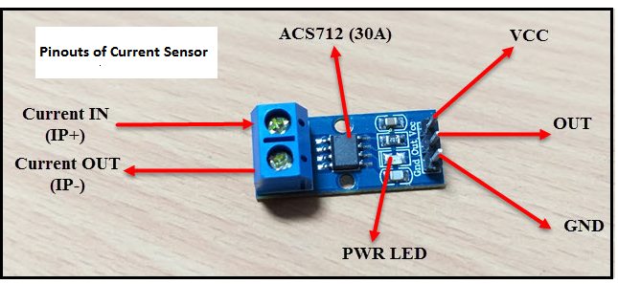
ACS712 Current Sensor :
The ACS712 is a Hall-effect-based linear sensor that measures motor current by detecting magnetic fields, providing a low-resistance path with built-in electrical isolation. In this predictive maintenance system, the ±5A variant is wired in series with the motor, offering a high sensitivity of 185 mV/A to detect subtle fluctuations. The Arduino processes the sensor’s analog output by calculating the voltage deviation from a 2.5V reference, triggering an "OVERLOAD!" alert if current exceeds 125% of the motor's rated capacity. This monitoring is critical for early fault detection, as progressive increases in current draw often signal bearing wear, rotor eccentricity, or impending mechanical jams before catastrophic failure occurs.
Parameter | Specification
Current Range | ±5A, ±20A, ±30A (variants)
Supply Voltage (VCC) | 5V
Output Sensitivity (±5A model) | 185 mV/A
Zero-Current Output Voltage | VCC/2 = 2.5V
Bandwidth | 80 kHz
Total Output Error | ±1.5% (typical)
Internal Resistance | 1.2 mΩ
Operating Temperature | -40°C to +85°C
Package | SOIC-8

Slide 23
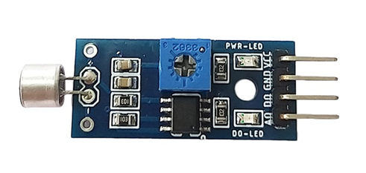
SOUND SENSOR MODULE :
Hardware Architecture: Features an electret condenser microphone integrated with an LM393 voltage comparator for both digital thresholding and continuous analog output.
Data Acquisition: The analog output is mapped to the Arduino’s A3 channel, providing a real-time measurement of acoustic pressure and energy levels.
Predictive Diagnostic Value: Enables early detection of faults that precede structural failure, such as:
Bearing Defects: Squealing or grinding from spalled raceways.
Gear Damage: Clicking/rattling at specific mesh frequencies.
Pump Cavitation: Distinctive high-frequency crackling sounds.
Intelligent Alerting: Automatically triggers a "NOISE!" alert when acoustic levels exceed a predefined threshold, signaling the need for immediate operator inspection.
Cost-Effective Scalability: Provides a low-cost "edge" detection solution while allowing raw data to be exported for advanced FFT (Fast Fourier Transform) or ML-based pattern recognition on cloud platforms.

Slide 24
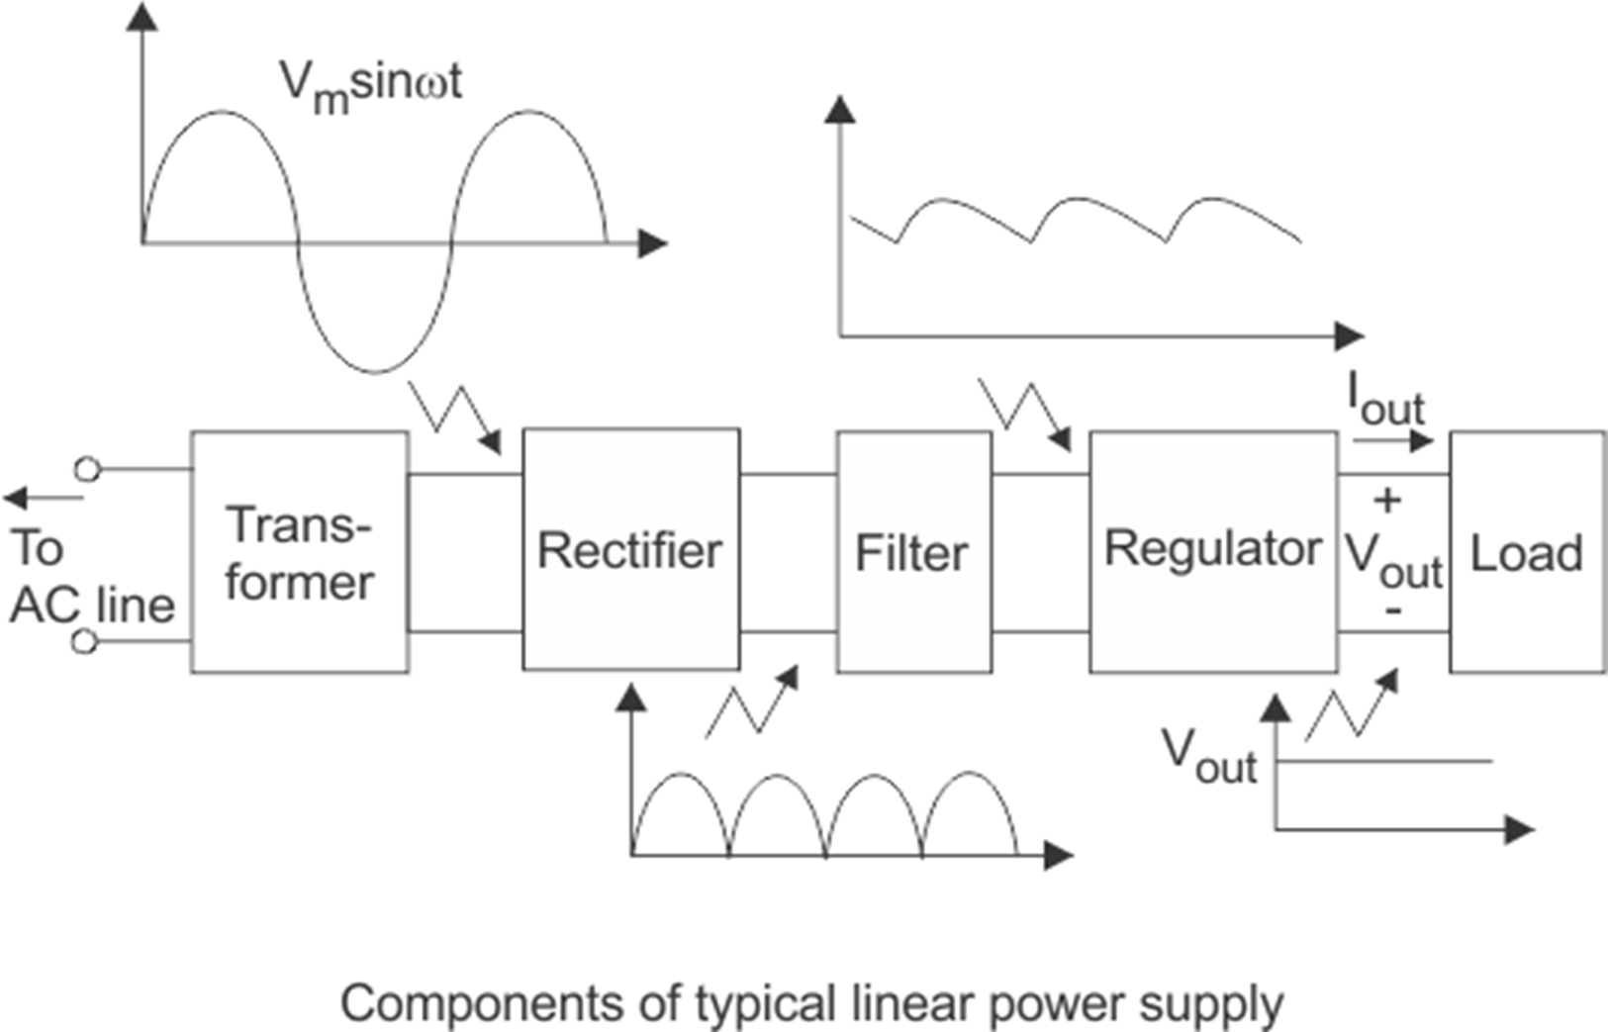
POWER SUPPLY :
A power supply is a device that converts one voltage to another more convenient voltage while delivering power. Power supplies are designed from the output back to the input.
There are three major kinds of power supplies: unregulated (also called brute force), linear regulated, and switching. The fourth type of power supply circuit called the ripple-regulated, is a hybrid between the “brute force” and “switching” designs, and merits a subsection to itself.

Slide 25
WORKING :
The AC voltage is connected to a transformer, which steps that ac voltage down to the level for the desired dc output.
A diode rectifier then provides a full-wave rectified voltage.
This is initially filtered by a simple capacitor filter to produce a dc voltage.
This resulting dc voltage usually has some ripple or ac voltage regulation.
A regulator circuit can use this dc input to provide a dc voltage that not only has much less ripple voltage but also remains the same dc value even if the input dc voltage varies somewhat or the load connected to the output dc voltage changes.
This voltage regulation is usually obtained using one of the voltage regulator IC units.

Slide 26
SKETCH :
A sketch is an Arduino program uploaded to the board.
Contains instructions the microcontroller executes.
Basic structure includes:
setup() – runs once for initialization
loop() – runs repeatedly
Uses functions, variables, and logic to control hardware.
Key Functions :
pinMode(pin, mode): Sets pin as INPUT or OUTPUT.
digitalWrite(pin, value): Sends HIGH or LOW signal.
delay(ms): Pauses program for specified milliseconds.
Example (Blink LED):
pinMode(13, OUTPUT);
digitalWrite(13, HIGH);
delay(1000);

Slide 27
RESULT
EXPERIMENTAL RESULTS SUMMARY :
Fault Condition | Threshold Value | Simulated Value | Detection Time (s) | Alert Displayed
Tilt/Vibration | > 15° | 20° | < 1.5 | TILT!
Temperature | > 60°C | 67°C | < 2.0 | HOT!
Acoustic Noise | > 600 ADC | 720 ADC | < 1.0 | NOISE!
Current Overload | > 3.0 A | 3.4 A | < 1.5 | OVERLOAD!
Under-voltage | < 10.8 V | 9.5 V | < 1.0 | VOLT ERR!
Normal Operation | All within range | All within range | N/A | System OK

Slide 28
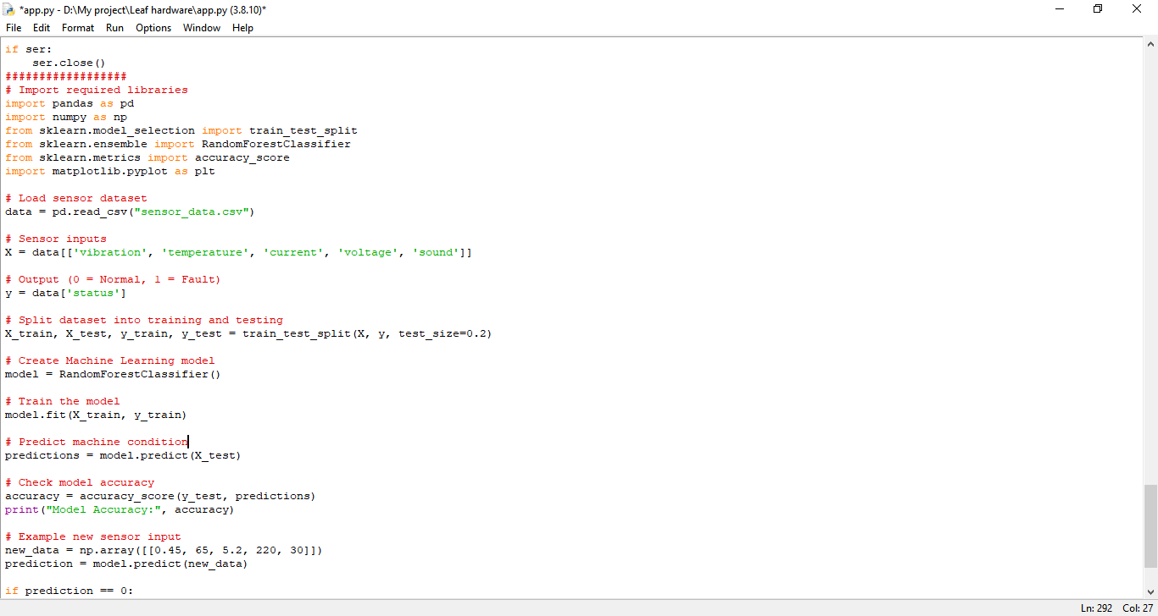
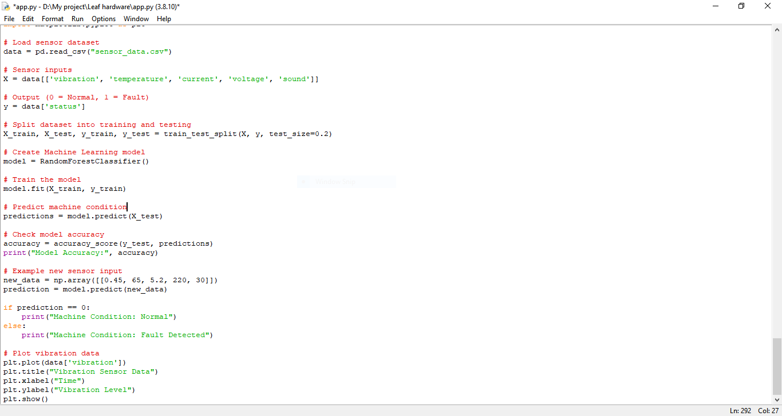
RESULT

Slide 29
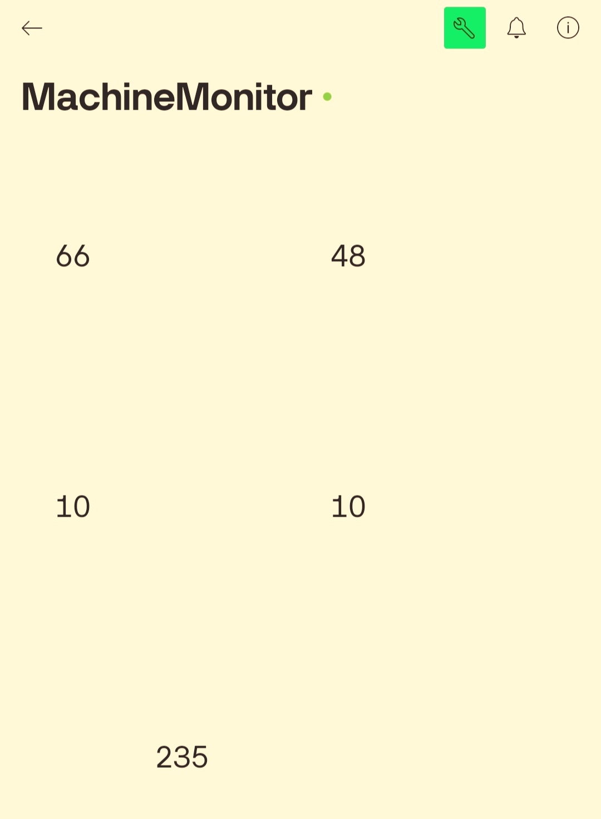
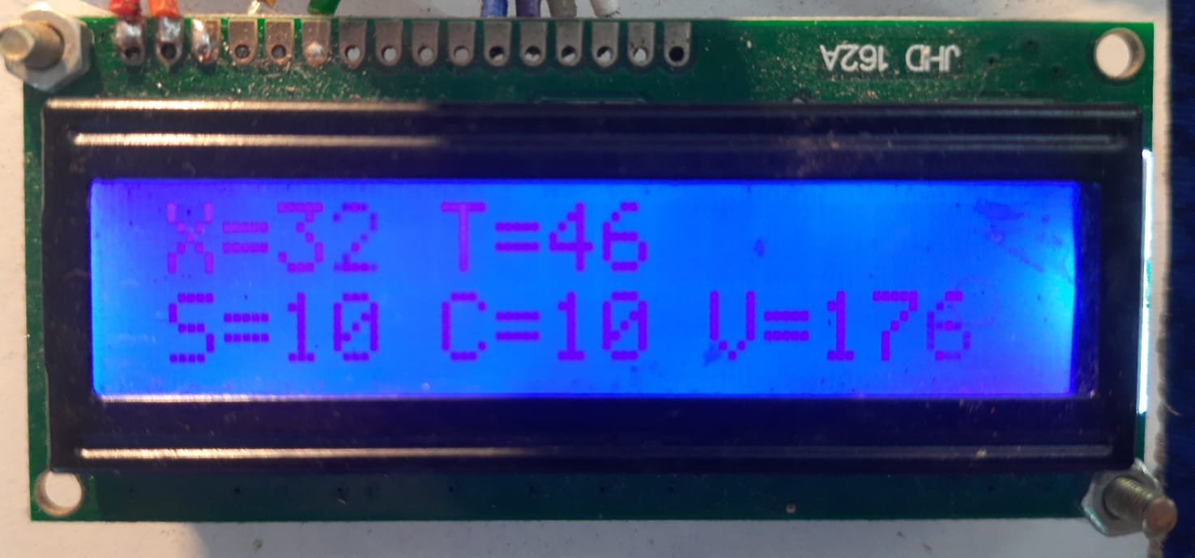
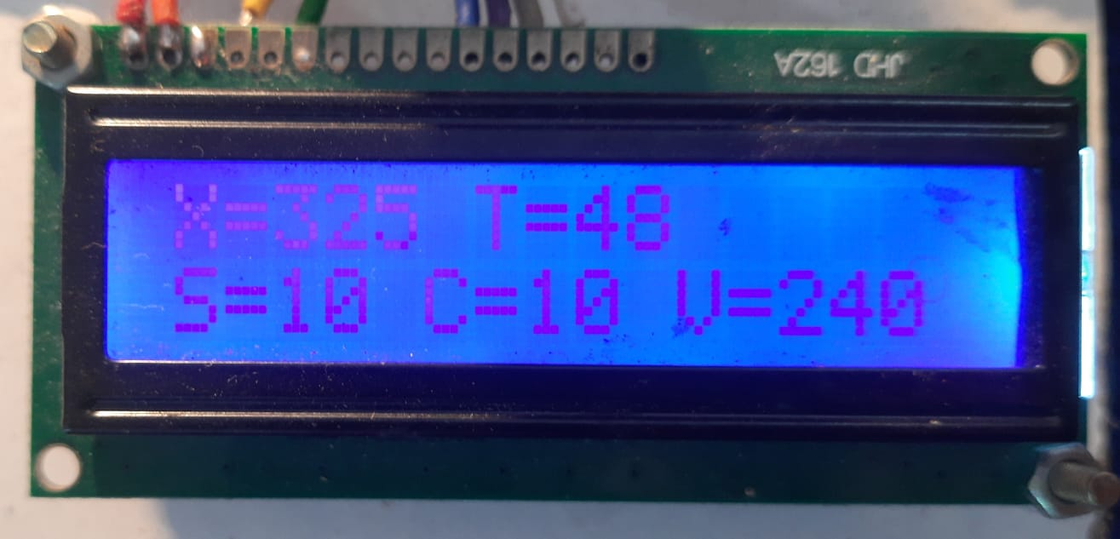
RESULT
IOT Dashboard Outputs :
LCD Display Outputs:

Slide 30
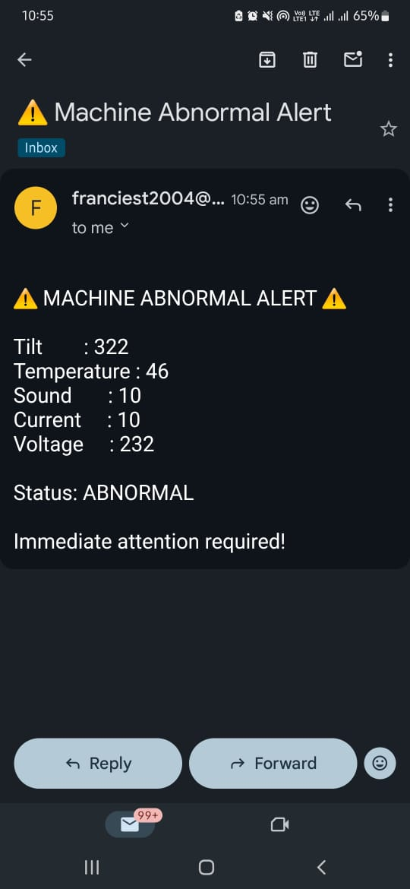
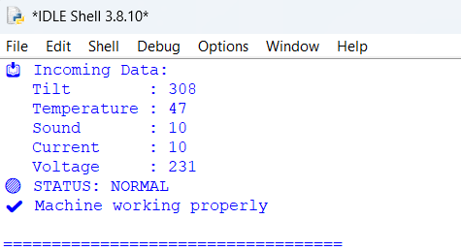
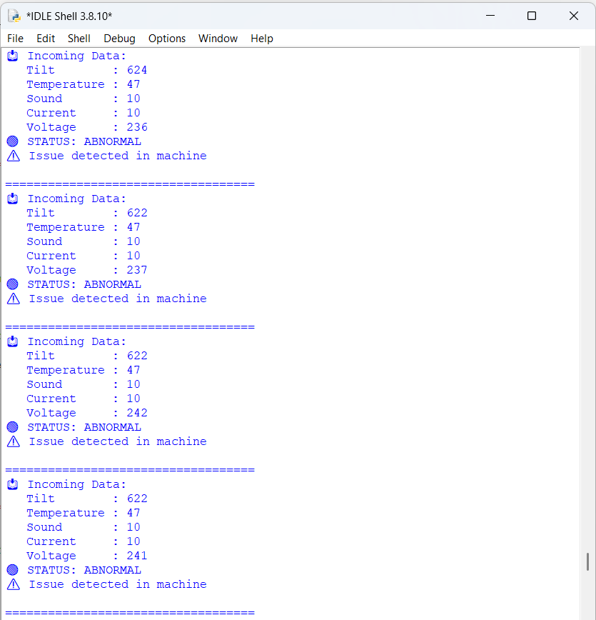
RESULT
Program Runtime Output :
Normal Condition:
Abnormal Condition :
Email Alert :

Slide 31
CONCLUSION
The proposed AI-Driven Predictive Maintenance System for Rotating Machinery successfully integrates multisensory data acquisition with intelligent fault prediction techniques. By continuously monitoring vibration, temperature, current, and voltage parameters, the system enables early detection of mechanical and electrical abnormalities.
The implementation of machine learning algorithms enhances fault diagnosis accuracy and supports condition-based maintenance strategies. This approach reduces unplanned downtime, lowers maintenance costs, and improves overall machine reliability. The system’s modular and scalable architecture makes it suitable for real-time industrial deployment and future upgrades, contributing to smarter and more efficient industrial automation.

Slide 32
REFERENCES
Lycksam, A., O’Nils, M., & Qureshi, F. Z. (2025). A Prognostic Framework for Rotating Machines Considering Multi-Component Fault Scenarios. IEEE Access, Vol. 13. doi:10.1109/ACCESS.2025.3572582.
Shuriya B. (2026). AI-Powered Predictive Maintenance via Sensor Fusion and Machine Learning in Downtime Reduction and Equipment Efficiency in Industry 4.0 Manufacturing Plants. Preprints.org. doi:10.20944/preprints202601.0120.v1.
Bisht, S. S., Charaya, S., & Mehta, R. (2025). IoT-Driven Predictive Maintenance Model for Rotating Machinery Using Machine Learning and Deep Learning Techniques. International Journal of Research and Technology (IJRT).
Ruksana. (2025). Advancing Predictive Maintenance with Edge AI and IoT Integration in Industrial Systems. International Journal of Scientific Research & Engineering Trends (IJSRET), 11(2).
Yamamoto, K. (2025). Role of AI-Based Predictive Maintenance in Reducing Operational Downtime in Industrial Units. International Journal of Engineering Management Research and Development (IJEGMRD), 2(1).
Kaveri S., John, K. S., Satheesh, P., Wilson, R. K., & John, J. (2025). Predictive Maintenance of Machines Using IoT and Machine Learning. International Journal on Emerging Research Areas (IJERA).

Slide 33
FUTURE WORK
1. Advanced Signal Processing
Apply FFT, wavelet analysis for precise fault identification
Detect bearing faults, imbalance, and gear defects
2. Remaining Useful Life (RUL) Prediction
Estimate time to failure
Enable optimal maintenance scheduling
3. Digital Twin Technology
Create virtual model of machinery
Compare real-time data with simulated behavior
4. Fleet Monitoring & Cloud Analytics
Monitor multiple machines centrally
Perform large-scale data analysis & benchmarking

Slide 34
THANK YOU

